Slide 1

Data Abstraction & Problem Solving with C++: Walls and Mirrors
Seventh Edition
Chapter 15
Trees
Copyright © 2017, 2013, 2007 Pearson Education, Inc. All Rights Reserved
Notes:
If this PowerPoint presentation contains mathematical equations, you may need to check that your computer has the following installed:
1) MathType Plugin
2) Math Player (free versions available)
3) NVDA Reader (free versions available)

Slide 2
Trees
Lists, stacks, and queues are linear in their organization of data
Items are one after another.
In this chapter, we organize data in a nonlinear, hierarchical form
Item can have more than one immediate successor

Slide 3
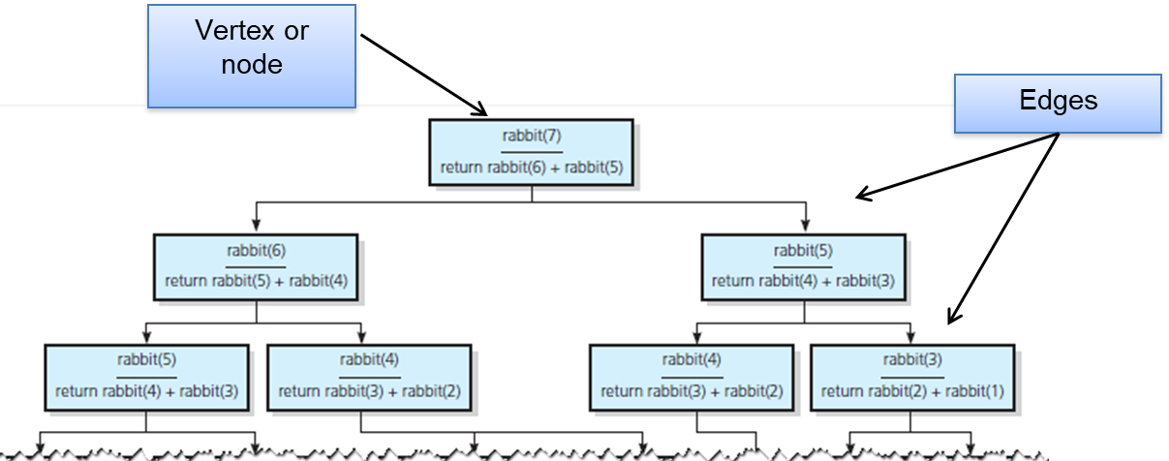
Terminology (1 of 3)
Use trees to represent relationships
Recall Figure 2-19 … diagram represents a tree

Slide 4
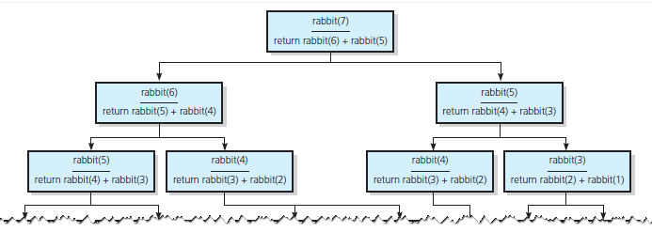
Figure 2-19 The Recursive Calls that Rabbit(7) Generates (1 of 2)

Slide 5
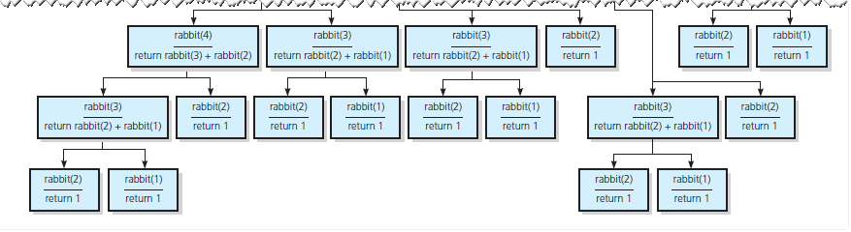
Figure 2-19 The Recursive Calls that Rabbit(7) Generates (2 of 2)

Slide 6
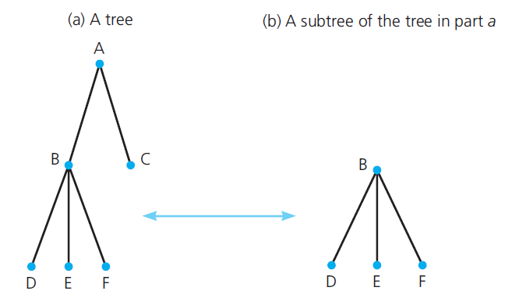
Terminology (2 of 3)
Trees are hierarchical in nature
Means a parent-child relationship between nodes
Figure 15-1 A tree and one of its subtrees

Slide 7
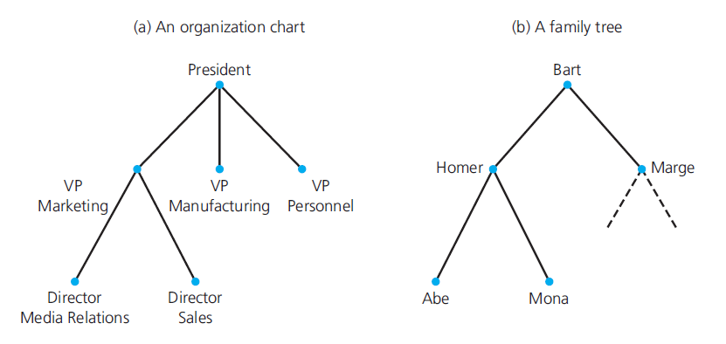
Terminology (3 of 3)
Figure 15-2

Slide 8
Kinds of Trees (1 of 3)
General tree
Set T of one or more nodes
T is partitioned into disjoint subsets
Binary tree
Set of T nodes – either empty or partitioned into disjoint subsets
Single node r, the root
Two (possibly empty) sets – left and right subtrees

Slide 9
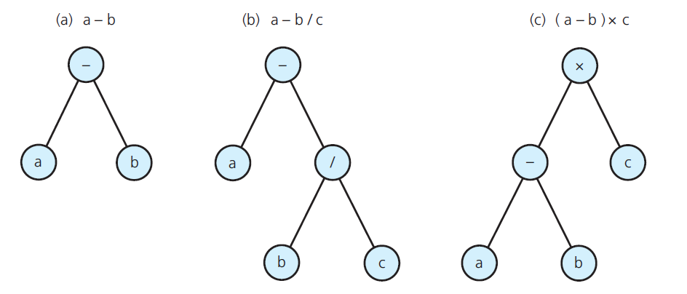
Kinds of Trees (2 of 3)
Figure 15-3 Binary trees that represent algebraic expressions

Slide 10
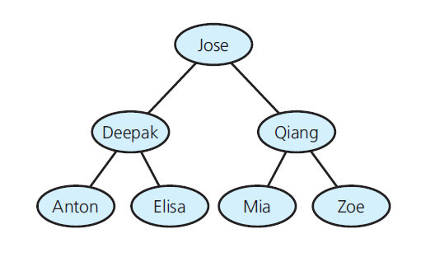
Kinds of Trees (3 of 3)
Figure 15-4 A binary search tree of names

Slide 11
The Height of Trees (1 of 2)
Level of a node, n
If n is root, level 1
If n not the root, level is 1 greater than level of its parent
Height of a tree
Number of nodes on longest path from root to a leaf
T empty, height 0
T not empty, height equal to max level of nodes

Slide 12
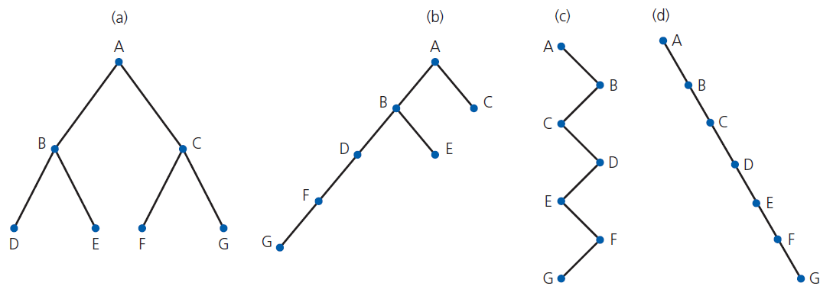
The Height of Trees (2 of 2)
Figure 15-5 Binary trees with the same nodes but different heights

Slide 13
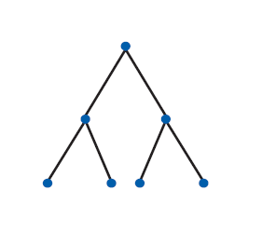
Full, Complete, and Balanced Binary Trees (1 of 2)
Figure 15-6 A full binary tree of height 3

Slide 14
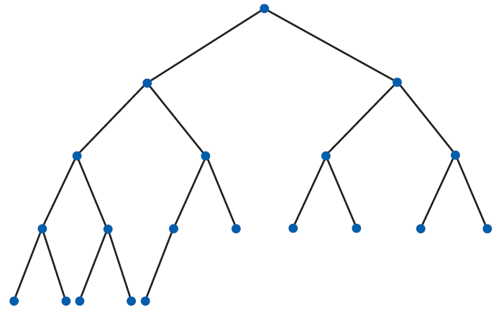
Full, Complete, and Balanced Binary Trees (2 of 2)
Figure 15-7 A complete binary tree

Slide 15
The Maximum and Minimum Heights of a Binary Tree (1 of 4)
Binary tree with n nodes
Max height is n
To minimize height of binary tree of n nodes
Fill each level of tree as completely as possible
A complete tree meets this requirement

Slide 16
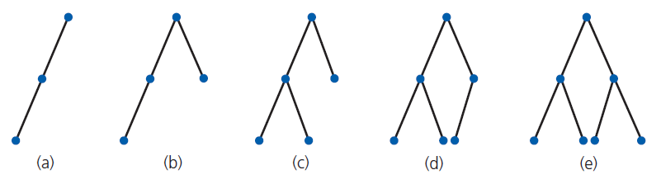
The Maximum and Minimum Heights of a Binary Tree (2 of 4)
Figure 15-8 Binary trees of height 3

Slide 17
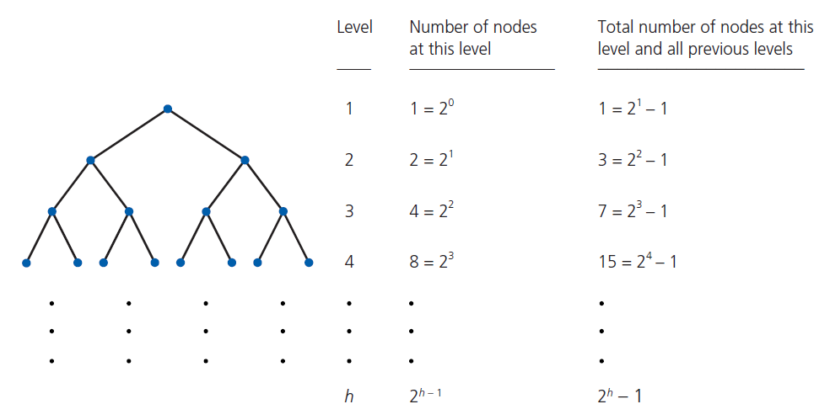
The Maximum and Minimum Heights of a Binary Tree (3 of 4)
Figure 15-9 Counting the nodes in a full binary tree of height h

Slide 18
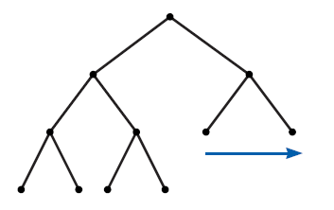
The Maximum and Minimum Heights of a Binary Tree (4 of 4)
Figure 15-10 Filling in the last level of a tree

Slide 19
The A D T Binary Tree
Operations of A D T binary tree
Add, remove
Set, retrieve data
Test for empty
Traversal operations that visit every node
Traversal can visit nodes in several different orders

Slide 20
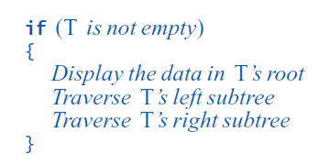
Traversals of a Binary Tree (1 of 6)
Pseudocode for general form of a recursive traversal algorithm

Slide 21
Traversals of a Binary Tree (2 of 6)
Options for when to visit the root
Preorder: before it traverses both subtrees
Inorder: after it traverses left subtree, before it traverses right subtree
Postorder: after it traverses both subtrees
Note traversal is O(n)

Slide 22
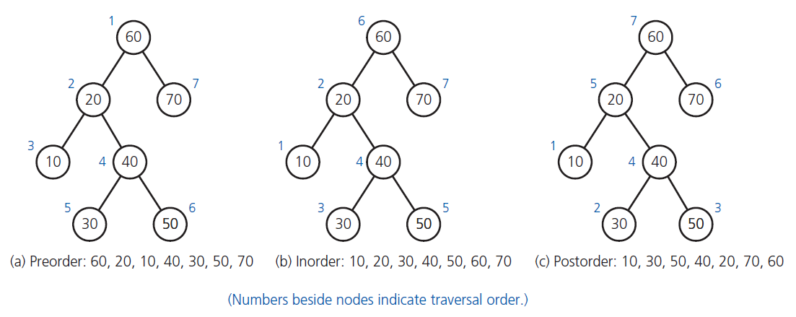
Traversals of a Binary Tree (3 of 6)
Figure 15-11 Three traversals of a binary tree

Slide 23
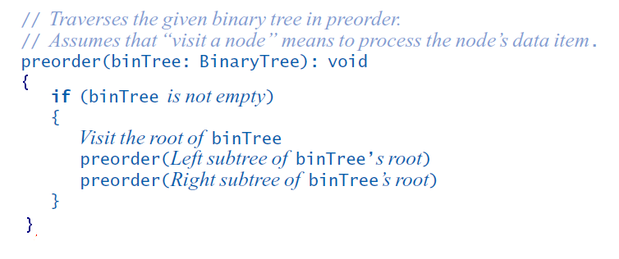
Traversals of a Binary Tree (4 of 6)
Preorder traversal algorithm

Slide 24
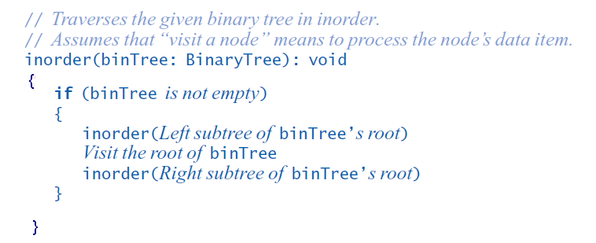
Traversals of a Binary Tree (5 of 6)
Inorder traversal algorithm

Slide 25
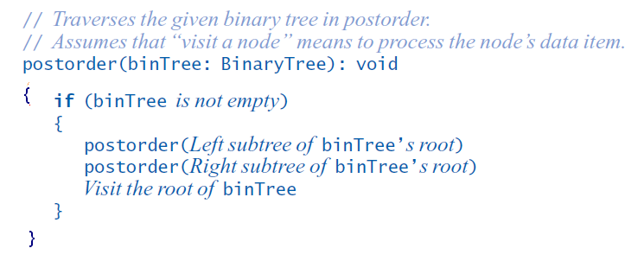
Traversals of a Binary Tree (6 of 6)
Postorder traversal algorithm

Slide 26
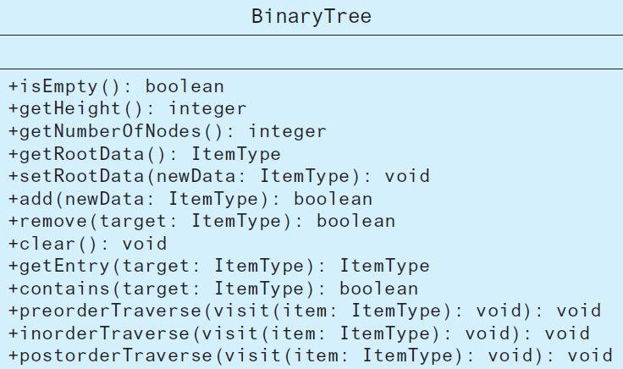
Binary Tree Operations
Figure 15-12 U M L diagram for the class BinaryTree

Slide 27
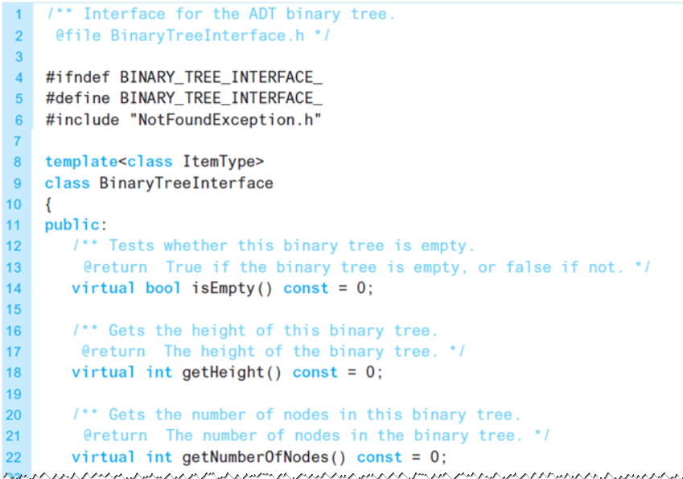
Interface Template for the A D T Binary Tree (1 of 4)
Listing 15-1 An interface template for the A D T binary tree

Slide 28
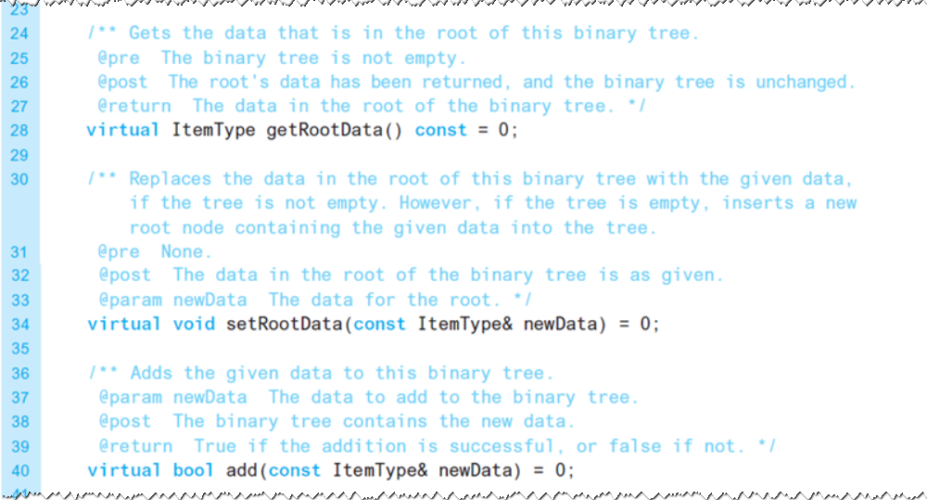
Interface Template for the A D T Binary Tree (2 of 4)
Listing 15-1 [Continued]

Slide 29
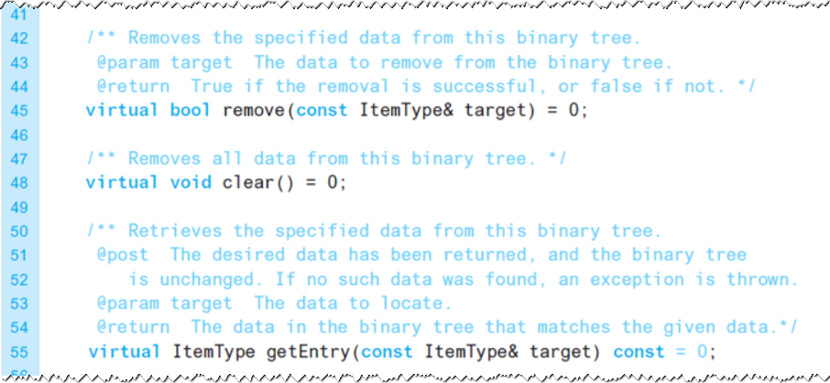
Interface Template for the A D T Binary Tree (3 of 4)
Listing 15-1 [Continued]

Slide 30
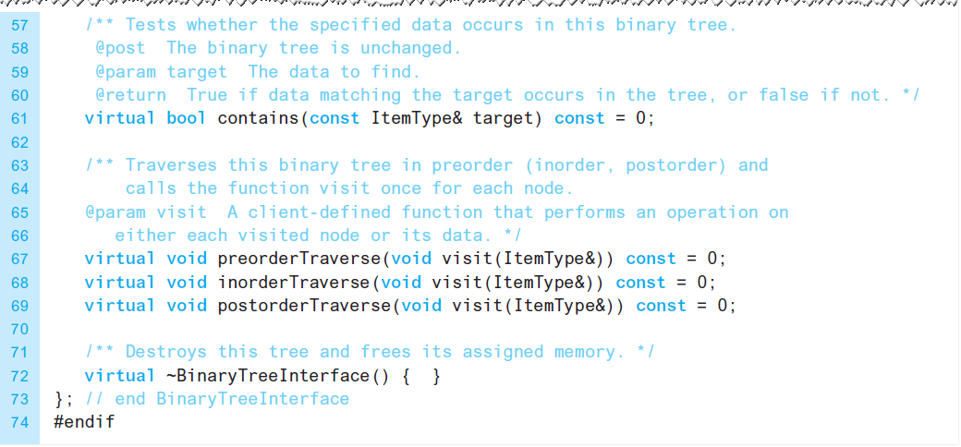
Interface Template for the A D T Binary Tree (4 of 4)
Listing 15-1 [Continued]

Slide 31
The A D T Binary Search Tree (1 of 2)
Recursive definition of a binary search tree
n’s value is greater than all values in its left subtree T_{L}.
n’s value is less than all values in its right subtree T_{R}.
Both T_{L} and T_{R} are binary search trees.

Slide 32
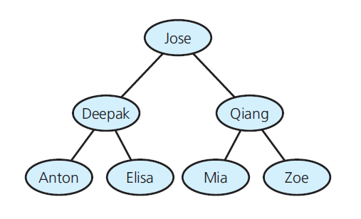
The A D T Binary Search Tree (2 of 2)
Figure 15-13 A binary search tree of names

Slide 33
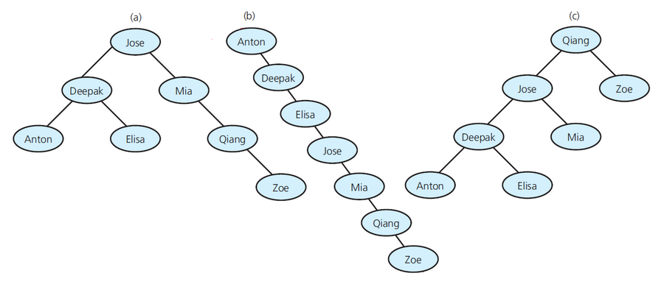
Binary Search Tree Operations (1 of 3)
Figure 15-14 Binary search trees with the same data as in Figure 15-13

Slide 34
Binary Search Tree Operations (2 of 3)
Test whether a binary search tree is empty.
Get the height of a binary search tree.
Get the number of nodes in a binary search tree.
Get the data in a binary search tree’s root.
Add the given data item to a binary search tree.
Remove the specified data item from a binary search tree.
Remove all data items from a binary search tree.

Slide 35
Binary Search Tree Operations (3 of 3)
Retrieve the specified data item in a binary search tree.
Test whether a binary search tree contains specific data.
Traverse the nodes in a binary search tree in preorder, inorder, or postorder.
Operations that define the A D T binary search tree

Slide 36
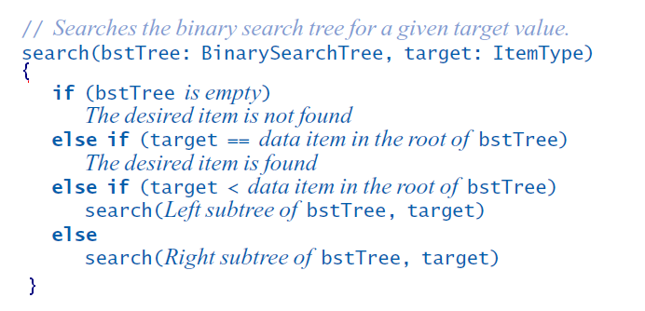
Searching a Binary Search Tree (1 of 2)
Search algorithm for a binary search tree

Slide 37
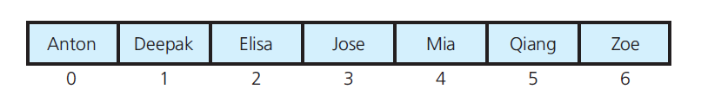
Searching a Binary Search Tree (2 of 2)
Figure 15-15 An array of names in sorted order

Slide 38
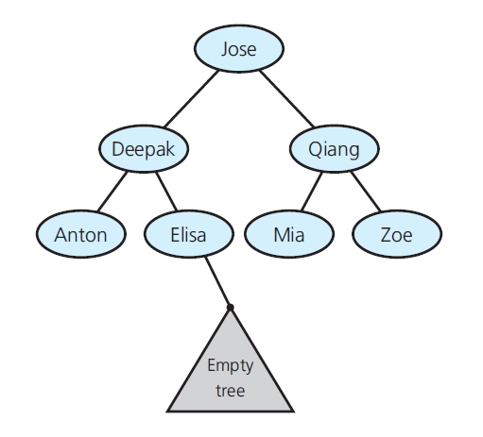
Creating a Binary Search Tree
Figure 15-16 Empty subtree where the search algorithm terminates when looking for Finn

Slide 39
Traversals of a Binary Search Tree
Inorder traversal of a binary search tree visits tree’s nodes in sorted search-key order

Slide 40
Efficiency of Binary Search Tree Operations (1 of 2)
Max number of comparisons for retrieval, addition, or removal
The height of the tree
Adding entries in sorted order
Produces maximum-height binary search tree
Adding entries in random order
Produces near-minimum-height binary search tree

Slide 41
Efficiency of Binary Search Tree Operations (2 of 2)
Figure 15-17 The Big O for the retrieval, addition, removal, and traversal operations of the A D T binary search tree
Operation | Average case | Worst case
Retrieval | O(log n) | O(n)
Addition | O(log n) | O(n)
Removal | O(log n) | O(n)
Traversal | O(n) | O(n)

Slide 42

Copyright

